Slide 1


Demonstration of types of viruses and its mechanism
Group 17

Slide 2
TABLE OF CONTENTS
01
02
Members & assignment
Problem statement
03
04
Use case diagram
General class diagram
05
06
Explanation of OOP techniques
Class diagrams for packages
07
Demo

Slide 3
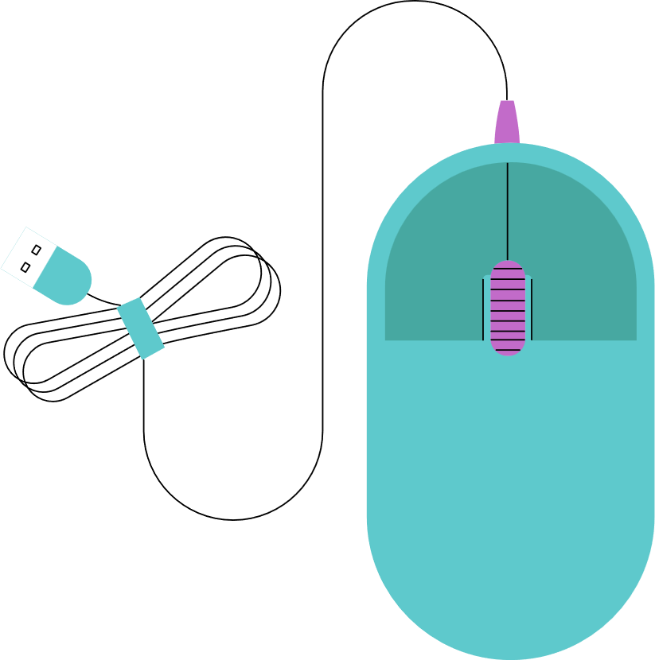
01
Members & assignment
Chu Trung Anh 20225564 (leader): package virus (20%), package gui (40%), README (50%), Slide (20%), Report (30%), Diagram (30%)
Phan Tran Viet Bach 20225435: package virus (60%), package gui (20%), README (20%), Slide (30%), Report (50%), Diagram (40%)
Nguyen Huu Cong 20225476: package virus (20%), package gui (40%), README (30%), Slide (50%), Report (20%), Diagram (30%)

Slide 4


02
Problem statement
In the realm of virology, understanding the structure and infection mechanisms of various viruses is crucial. However, the complexity of these microscopic entities often makes it challenging for students and researchers to grasp these concepts.
Providing an interactive platform where users can choose from various types of viruses for focused study.
View the detailed structure of a specific virus to understand its composition
Examine the detailed infection mechanism to learn how it operates.
Notes:
In the realm of virology, understanding the structure and infection mechanisms of various viruses is crucial. However, the complexity of these microscopic entities often makes it challenging for students and researchers to grasp these concepts. Traditional learning resources may not provide an interactive and engaging way to study these viruses.
Our project aims to address this issue by providing an interactive platform where users can choose from various types of viruses for focused study. They can view the detailed structure of a specific virus to understand its composition and examine the detailed infection mechanism to learn how it operates. The platform also provides text and video explanations for a comprehensive learning experience.

Slide 5
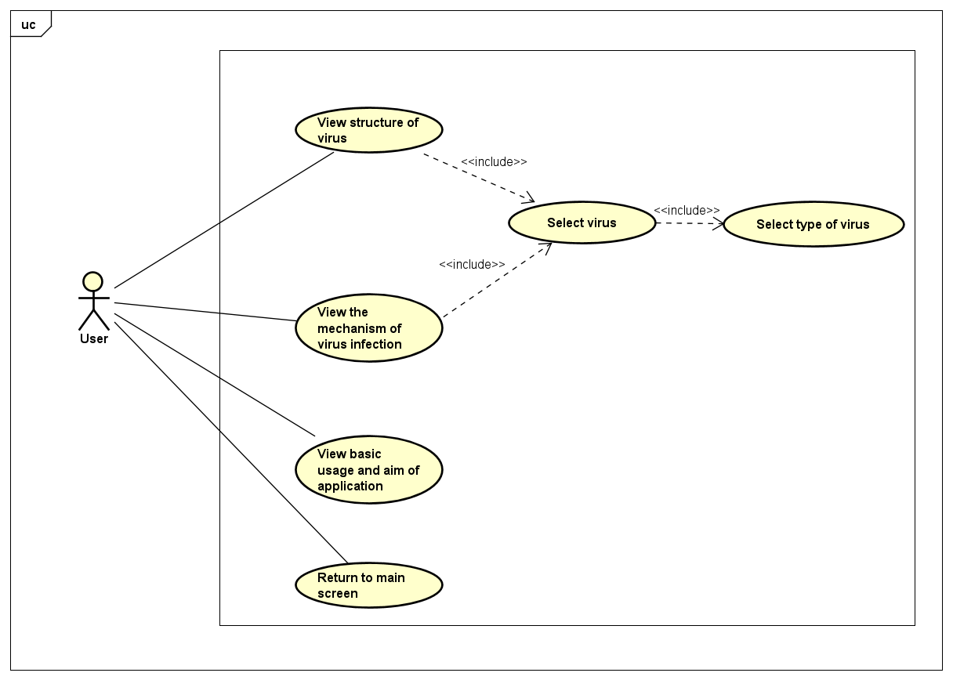
03
Use case diagram

Slide 6
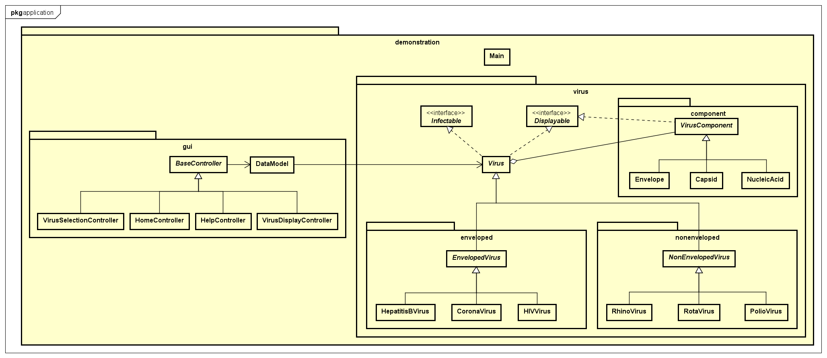

04
General class diagram

Slide 7
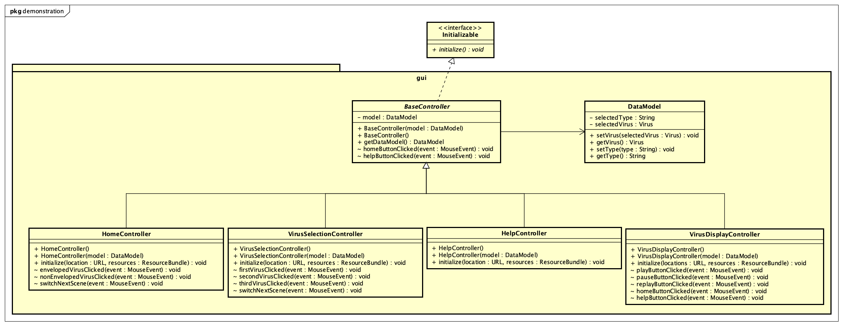
05
Detail class diagram
package “gui”

Slide 8
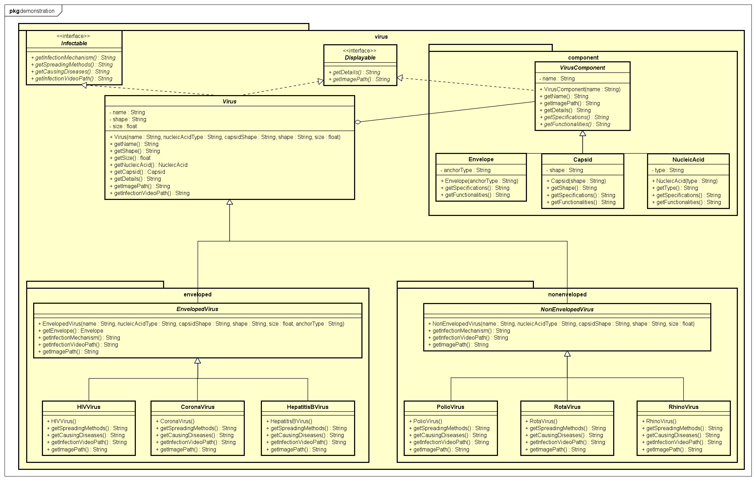
05
Detail class diagram

Slide 9

06
OOP techniques
Encapsulation
Attributes of class are set to private
Use Getter and Setter to access, modify the attributes
=> Remain Integrity of the data

Slide 10

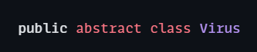
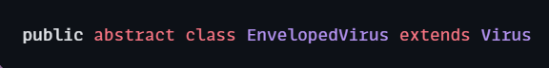
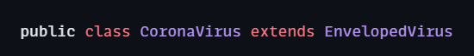
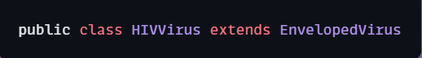
06
OOP techniques
Inheritance
. . . . . .
=> Reuse common attributes, methods between classes
Notes:
Abstraction in Java is the process in which we only show essential details/functionality to the user. The non-essential implementation details are not displayed to the user.
In Java, abstraction is achieved by interfaces and abstract classes.

Slide 11
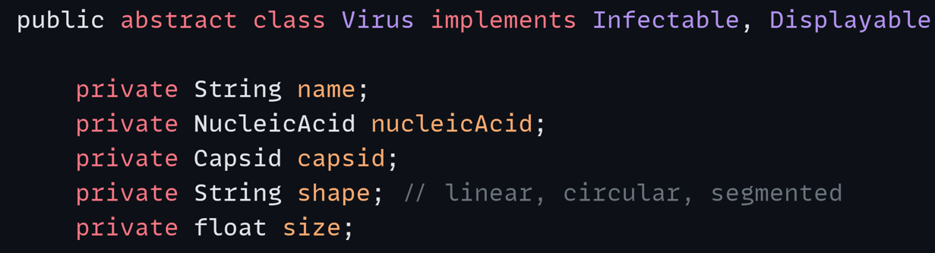
06
OOP techniques
Composition
Notes:
A method that can perform different tasks based on the object that it is acting. This is closely related to the concept of inheritance.

Slide 12
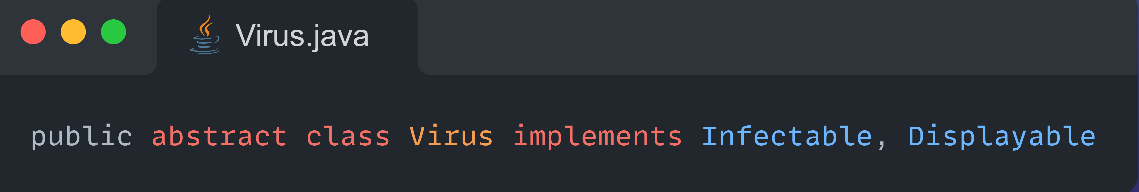
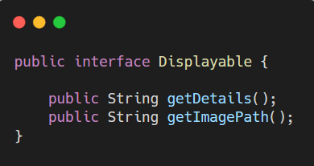
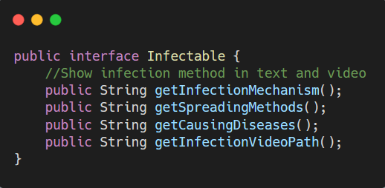
06
OOP techniques
Abstraction
Notes:
Abstraction in Java is the process in which we only show essential details/functionality to the user. The non-essential implementation details are not displayed to the user.
In Java, abstraction is achieved by interfaces and abstract classes.

Slide 13
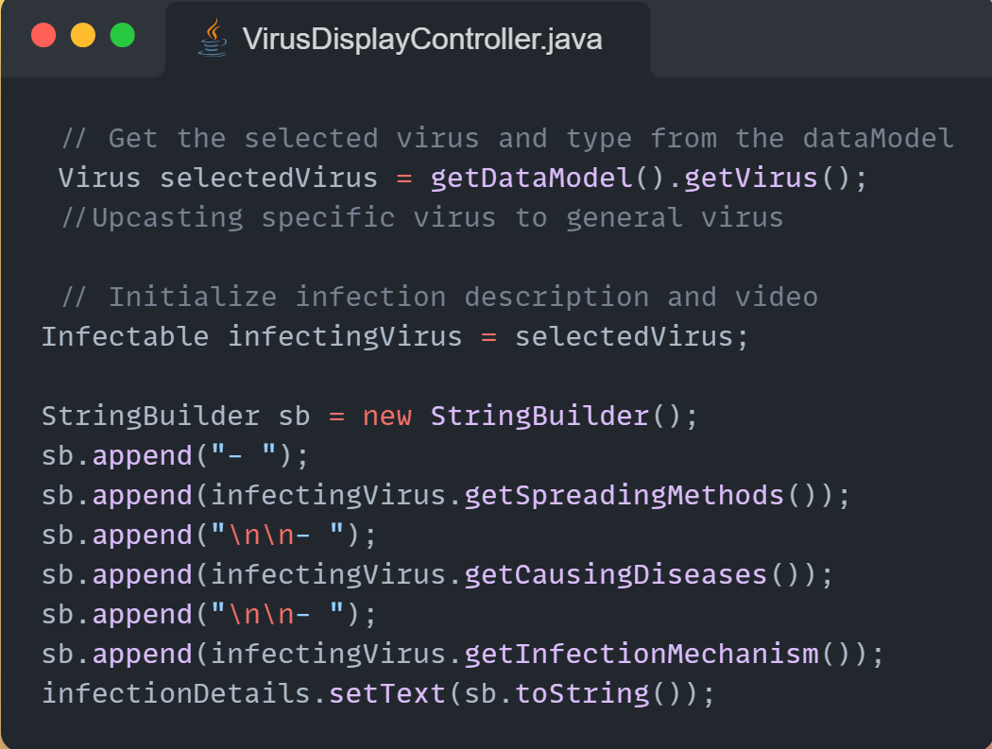
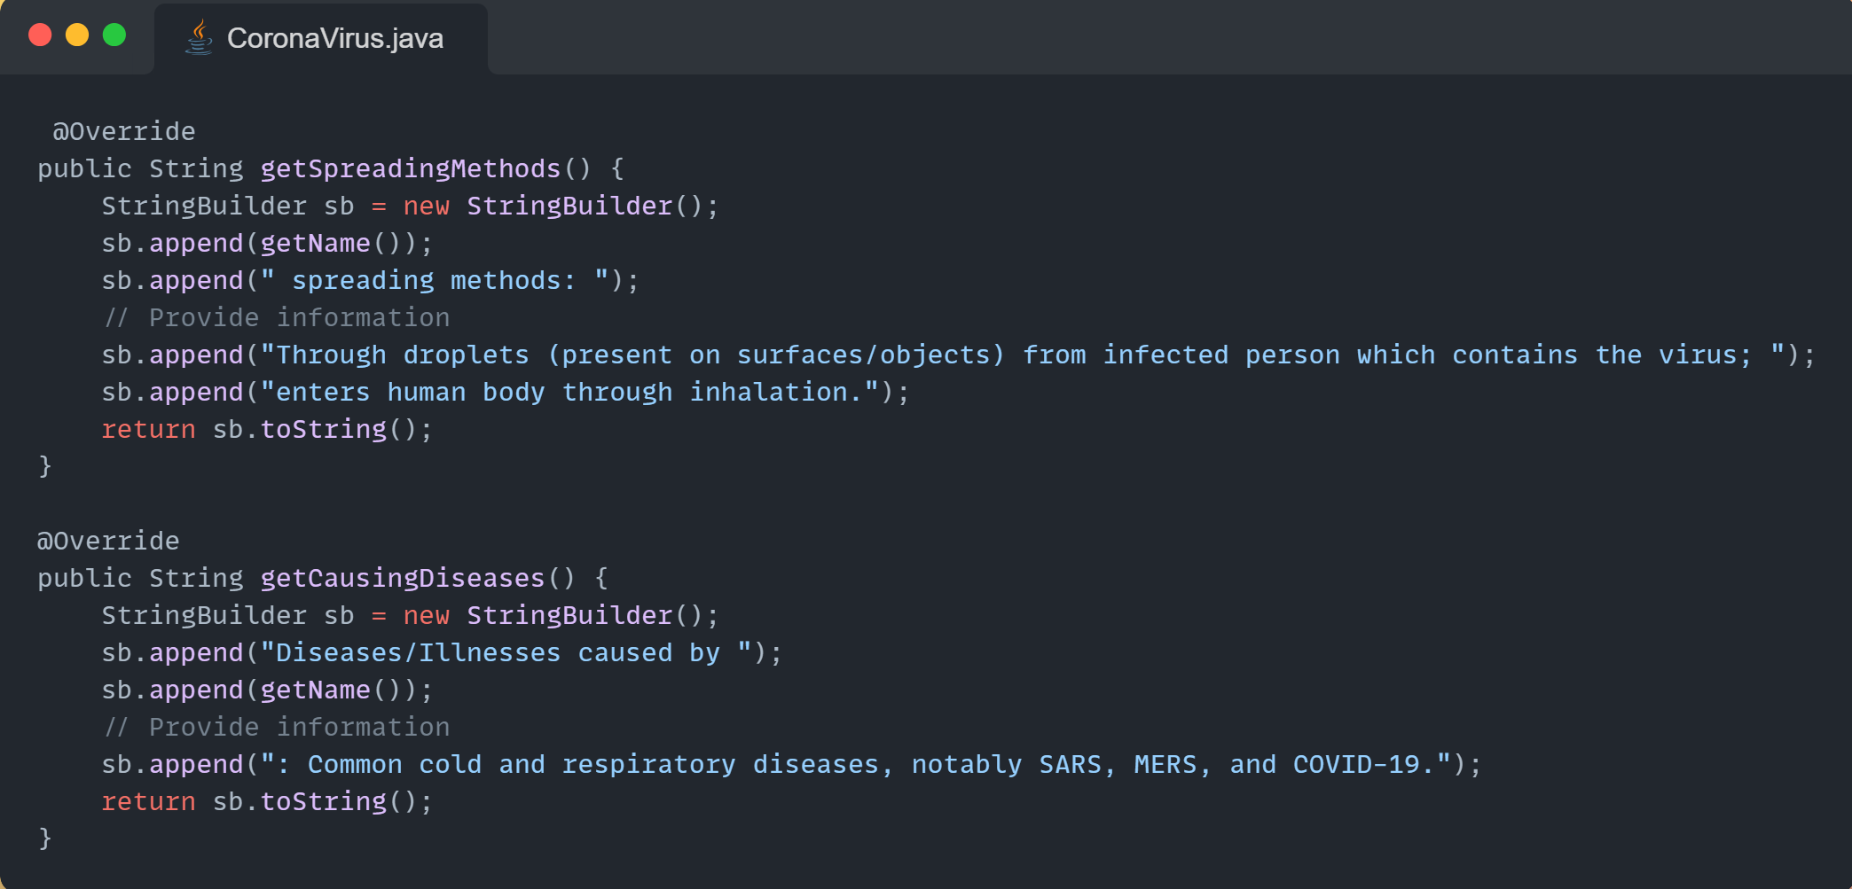
06
OOP techniques
Polymorphism
Notes:
In Object-Oriented Programming, polymorphism allows methods to perform different tasks based on the actual type of the object they're called on. This is closely related to the concept of inheritance.
In this code, the getSpreadingMethods() and getCausingDiseases() methods are part of an interface or superclass that the CoronaVirus class implements or extends. When these methods are called on a reference of type Virus, the actual method that gets executed depends on the actual type of the object that the reference points to.
For example, if the Virus reference points to a CoronaVirus object, the getSpreadingMethods() and getCausingDiseases() methods of the CoronaVirus class will be executed. This is determined at runtime by the Java Virtual Machine. So, even though the reference is of type Virus, the actual methods that get executed are those of the CoronaVirus class, because that's the actual type of the object.

Slide 14
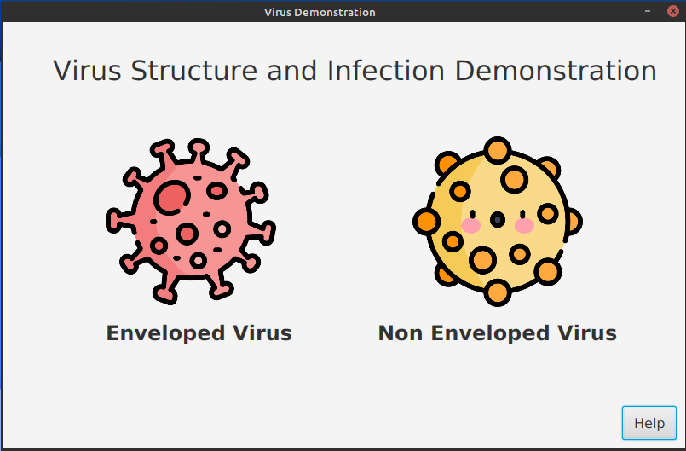
07
Demo

Slide 15
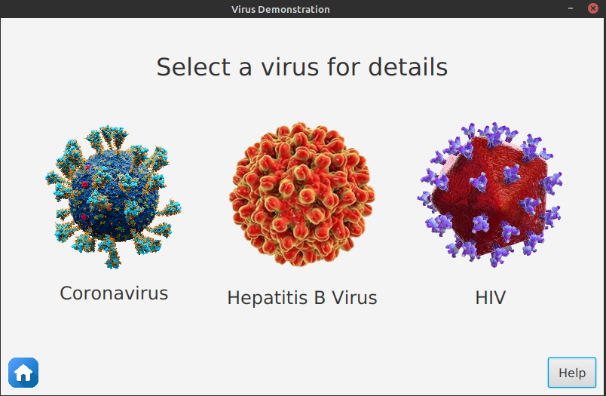
07
Demo

Slide 16
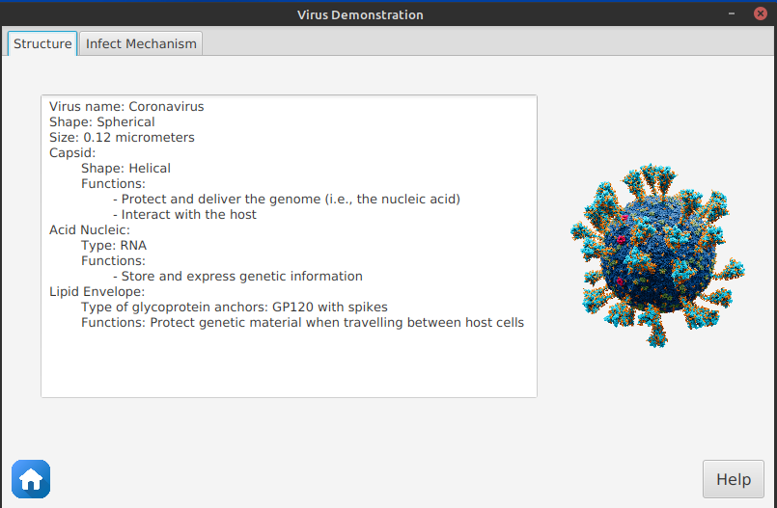
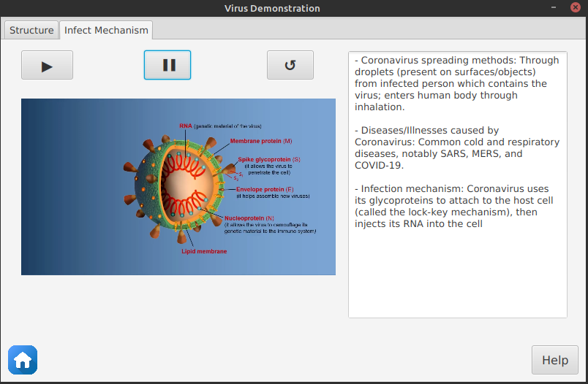
07
Demo

Slide 17
07
Demo

Slide 18
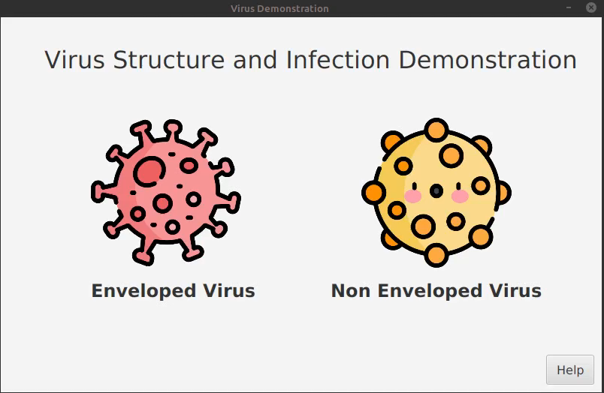

Slide 19

THANK YOU!

Slide 20
